Slide 1


ADVERTISING & DIGITAL AGENCY
Growing
brands
across cultures
MEDIA & CAPABILITIES
Beyond Brands. Beyond Boundaries.
Notes:
Mesmarek brand and positioning: https://mesmarek.com/. MSK logo and campaign concept image supplied by the current website, version 17. The image is an agency concept, not a record of a client campaign.
Cover artwork is an original generated emerald-glass sculpture created for Mesmarek. It is a decorative brand concept.

Slide 2
ABOUT MESMAREK
Advertising
shaped by
your audience
We connect strategy, creative, media and digital experiences for brands reaching new audiences and markets.
One connected plan.
A clear business objective.
MESMAREK
02
Notes:
Agency positioning and delivery scope: https://mesmarek.com/about/ and https://mesmarek.com/services/.

Slide 3
OUR CAPABILITIES
Four capabilities. One agency
01
Strategy & research
Audience insight, positioning
and campaign direction.
02
Brand & creative
Identity, campaign ideas
and creative localization.
03
Media & marketing
Paid campaigns, programmatic
and channel planning.
04
Web & measurement
Websites, eCommerce, analytics
and marketing systems.
SUPPORT SHAPED AROUND YOUR BRIEF
03
Notes:
Four service areas: https://mesmarek.com/services/. Engagement scope is agreed for each brief.

Slide 4












BRAND EXPERIENCE
Brands our
team has
worked with
Experience across categories,
audiences and markets.
MESMAREK
04
Notes:
Heading and 12 brand references match https://mesmarek.com/#brand-experience. These references describe work by the team, including experience before Mesmarek. They do not assert that the named brands commissioned Mesmarek or endorsed this deck. Artwork comes from the original brand assets already used on the website. Source URLs and role mapping are retained in the project records.

Slide 5

SELECTED CAMPAIGN / FOOD & HOSPITALITY
Restaurant
promotion
28.74%
ILLUSTRATIVE CAMPAIGN VISUAL
Landing-page-to-lead conversion
THE CAMPAIGN
A complimentary mocktail and discount offer for nearby diners.
0.87%
Geofencing, food-and-beverage interests and contextual food placements connected the offer with local audiences.
Click-through rate
Selected results. Performance varies by brief and media plan.
Notes:
Published case: https://mesmarek.com/media/#restaurant-case. Owner-authorized case study. Exact reported measures: 28.74% landing-page-to-lead conversion and 0.87% click-through rate. The unnamed campaign has no published spend, dates, absolute lead count or defined benchmark in the approved website copy. Do not interpret the result as a guarantee or as a website-wide conversion rate.
Restaurant image is a generated campaign visualization, not original campaign creative or a photograph of the actual restaurant.

Slide 6

SELECTED CAMPAIGN / AUTOMOTIVE
SUV launch
For a multicultural audience
86%
Video completion rate
ILLUSTRATIVE CAMPAIGN VISUAL
400K+
0.73%
81.23%
Audience reach
Click-through rate
Viewability
Multicultural targeting and video supported the launch. Metrics describe different aspects of delivery.
Notes:
Published case: https://mesmarek.com/media/#automotive-case. Owner-authorized case study. Exact reported metrics: 86% video completion rate, 400K+ reach, 0.73% click-through rate and 81.23% viewability. These measures have different denominators and must not be added together. No sales, dealership visits, test drives, campaign spend or benchmark is claimed.
SUV image is a generated campaign visualization. The vehicle is illustrative and is not the actual advertised model or source campaign creative.

Slide 7








INDUSTRIES
Food &
hospitality
Automotive
Sector
perspectives
Real estate
Education
Retail &
eCommerce
Financial
services
Campaigns shaped around the audience, category and commercial objective.
Healthcare &
wellness
Technology
MESMAREK
07
Notes:
Industry focus areas: https://mesmarek.com/. These are offered sector capabilities, not a claim of named clients or quantified results in every industry.

Slide 8
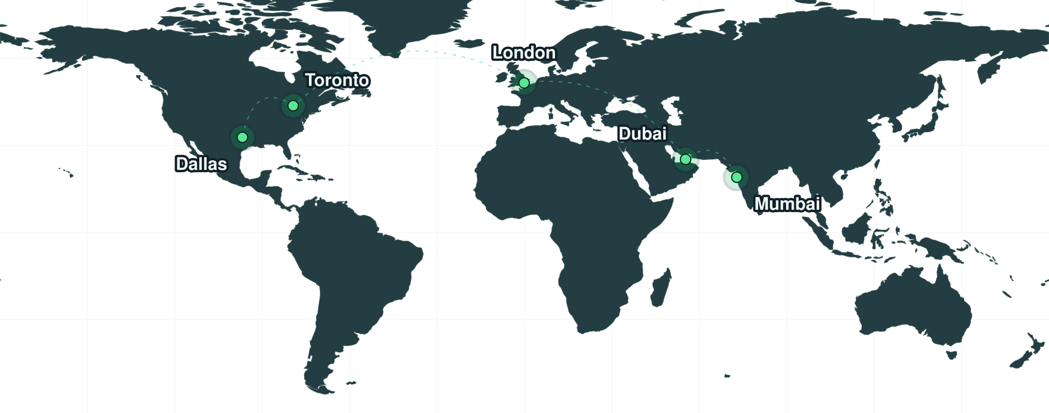
OUR OFFICES
Five cities
Connected thinking
Dubai
Toronto
Dallas
Mumbai
London
MESMAREK
08
Notes:
Owner-confirmed office cities: https://mesmarek.com/about/#offices. Map reused from the website with city-level points. Geography: Natural Earth (https://www.naturalearthdata.com/); city data: Natural Earth and GeoNames (https://www.geonames.org/). City locations, not office premises.

Slide 9
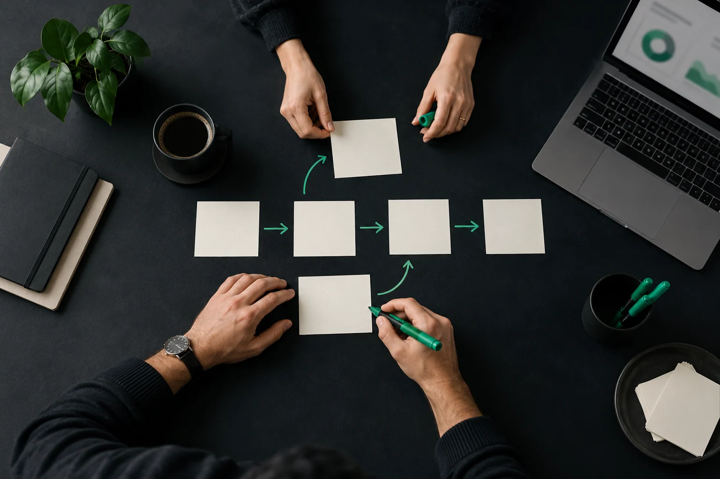
STRATEGY & RESEARCH
The thinking behind
the campaign
Audience & market
Audience, language and competitor research. Customer journeys and cultural context.
Positioning & messaging
A clear brand position and message for the intended audience.
Campaign direction
Channel and budget planning, objectives and measures of success.
MESMAREK
09
Notes:
Strategy scope: https://mesmarek.com/services/#strategy. The original website image is a service concept.

Slide 10
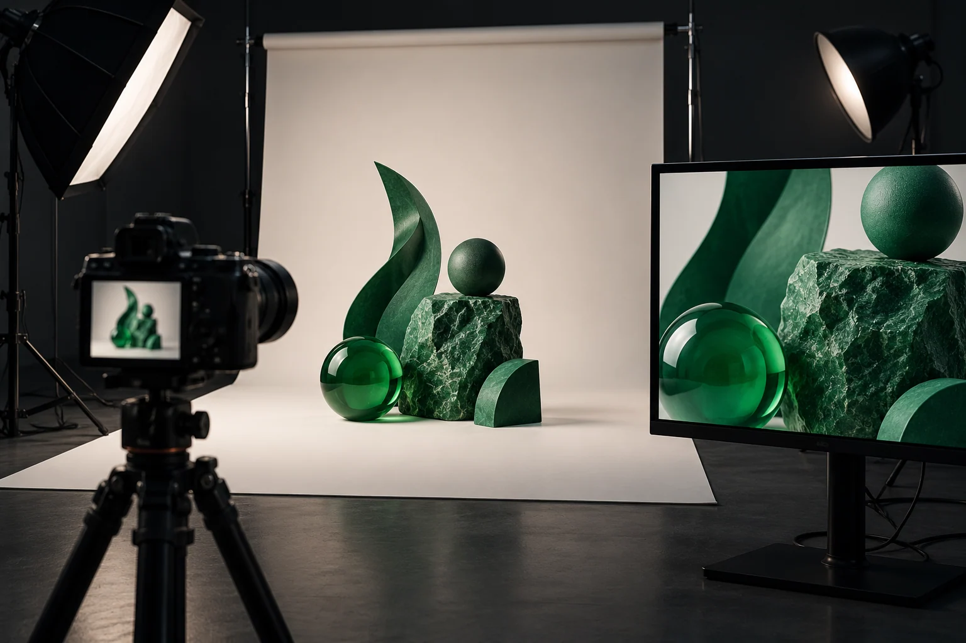
BRAND & CREATIVE
Brand & creative
Identity & campaign ideas
Brand identity and a creative direction for the campaign.
Copy & localization
Ad and landing page copy, transcreation and localization.
Content & adaptation
Social and rich media planning. Video, subtitles and voiceovers.
SERVICE CONCEPT
Notes:
Creative scope: https://mesmarek.com/services/#creative. Language and production requirements are agreed for the brief. The original website image is a service concept.

Slide 11

WEB & MEASUREMENT
Digital
& measurement
Websites
eCommerce
Analytics & systems
WordPress websites and landing pages built around the next customer action.
Shopify, WooCommerce and localized product content.
GA4, GTM, UTMs and conversion reviews. CRM and automation planning.
MESMAREK
11
Notes:
Web, commerce and measurement scope: https://mesmarek.com/services/#digital. Platform names describe services, not certifications. Original website service concept image.

Slide 12
MEDIA & DIGITAL MARKETING
The role of each channel
Objective | Channel roles | Measures to consider
Awareness | Video, CTV, audio, display and digital outdoor | Reach, impressions, viewability and video completion
Consideration | Paid social, creators, rich media and relevant content placements | Engagement, clicks and landing page visits
Conversion | Search, shopping, retargeting and relevant destination pages | Tracked leads or purchases and cost per agreed action
The objective guides the media mix and the measures agreed before launch.
MESMAREK
12
Notes:
Planning framework synthesized from https://mesmarek.com/media/ and https://mesmarek.com/services/#media. Channel roles are planning choices, not guaranteed outcomes. No budget allocation or benchmark is assumed.

Slide 13
AUDIENCE PLANNING
Relevance starts
with the audience
Relevant signals connect the brief with the media plan.
01
Content & context
02
Language & culture
Relevant content, keywords
and publishing environments.
Language preferences
and cultural context.
03
Geography
04
Interests & behaviour
Markets, local areas
and location requirements.
Interests, customer audiences
and retargeting.
Available customer and publisher data can inform targeting where appropriate.
MESMAREK
13
Notes:
Audience and contextual planning: https://mesmarek.com/media/#audiences and https://mesmarek.com/media/#technology. Available signals depend on the buying platform and campaign.

Slide 14
MULTICULTURAL PLANNING
Culture shapes
the campaign
01
02
03
04
Understand
Adapt
Review
Activate
Audience needs, language
and the occasion.
Copy, imagery and calls
to action for the audience.
Transcreation, subtitles,
voiceover and language.
Relevant media, formats
and performance feedback.
Language support, cultural review and seasonal media availability are confirmed for the brief.
MESMAREK
14
Notes:
Workflow based on https://mesmarek.com/media/#audiences and the creative localization service at https://mesmarek.com/services/#creative. This is an editable delivery diagram, not a claim of support for every language or market.

Slide 15
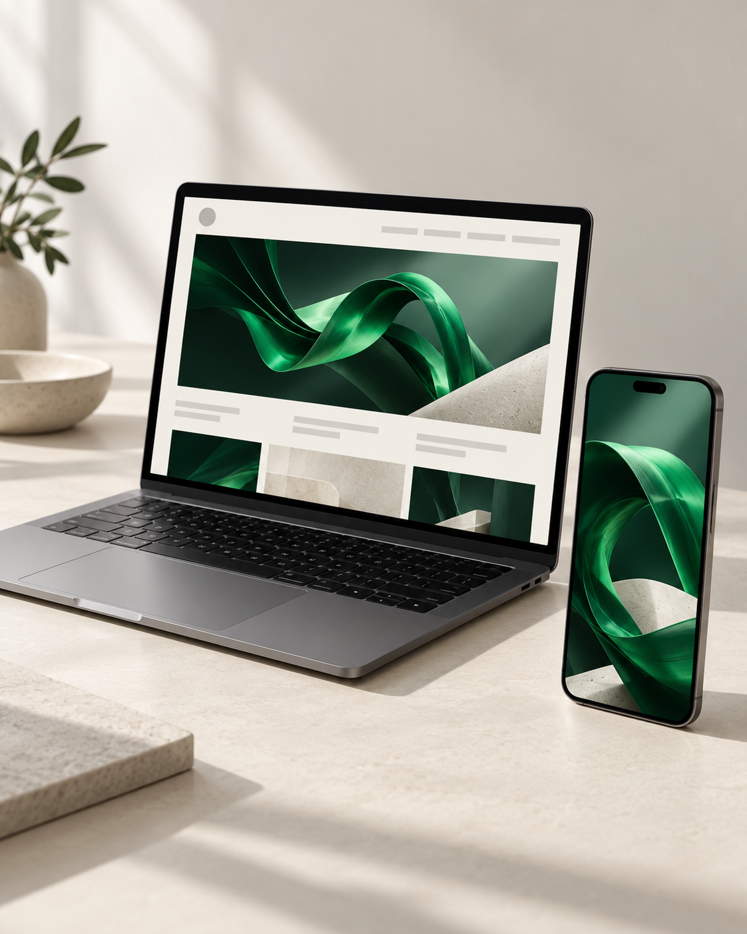
MEDIA FORMATS
Display
& interactive creative
Display & native
Web and app placements.
Expandable & interstitial
Larger creative where inventory supports it.
Swipe, cube & parallax
Interactive formats with clear calls to action.
Interactive video
Video adapted to placement and audience.
ILLUSTRATIVE MEDIA CONCEPT
Notes:
Media formats: https://mesmarek.com/media/#technology and https://mesmarek.com/media/#channels. Specifications and format availability are agreed in the proposal. Image generated for this deck as a neutral laptop and smartphone media concept in the Mesmarek palette. It does not represent client work or a documented campaign.

Slide 16
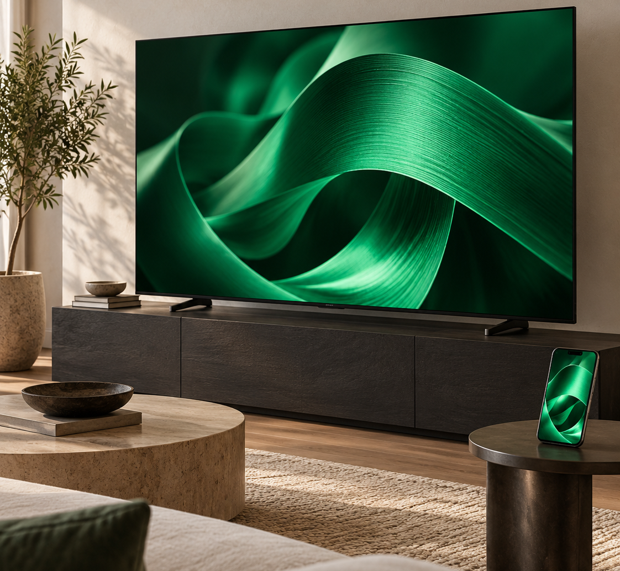
MEDIA FORMATS
Video & connected TV
Online video
Pre-roll and in-stream placements. Audience and content context guide creative adaptation.
Companion creative where available.
Connected TV
Streaming TV placements matched to audience, market and language. Inventory, specifications, frequency and reporting are agreed for the plan.
ILLUSTRATIVE MEDIA CONCEPT
Notes:
Video and CTV scope: https://mesmarek.com/media/#channels. Metrics depend on the inventory and campaign. Image generated for this deck as a neutral connected TV and mobile media concept in the Mesmarek palette. It is illustrative and does not represent client work.

Slide 17
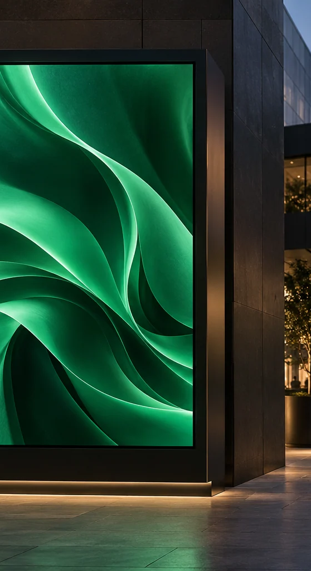



MEDIA FORMATS
Audio, outdoor
& community
Audio & community radio
Audio spots and sponsorships. Language, station and content selection.
Digital outdoor
Screen placements shaped around locations, formats and occasions.
Community activations
Event and community opportunities, with agreed production scope.
ILLUSTRATIVE MEDIA CONCEPT
Notes:
Audio, outdoor and community scope: https://mesmarek.com/media/#channels. Inventory, language options, locations and production requirements are confirmed for each proposal.

Slide 18
PERFORMANCE CHANNELS
Paid
social
Creator
campaigns
Search &
commerce
Audience and campaign planning. Activation, creative tests and reporting.
Audience and language fit. Creator selection, content briefs and planning.
Search and shopping campaigns. Landing pages, product pages and conversion measurement.
Creative tests inform
the next iteration.
Deliverables and terms
are scoped for the brief.
The ad and destination
share a conversion goal.
Notes:
Paid social, creator, search and commerce capabilities: https://mesmarek.com/media/#channels and https://mesmarek.com/services/#media. Creator deliverables and commercial terms are scoped for each brief.

Slide 19
MEDIA TECHNOLOGY
A connected
media workflow
Audience signals guide activation. Delivery and performance inform the next decision.
01
02
03
04
Understand
Activate
Engage
Improve
Audience & context
Buying & curation
Creative delivery
Measurement & quality
Content, keywords, language, geography and interest signals.
Curated inventory, channel mix, pacing and frequency.
Interactive formats adapted to the placement and idea.
Performance, viewability and delivery quality.
MESMAREK
19
Notes:
Media technology scope: https://mesmarek.com/media/#technology. No exclusive proprietary platform, audience size, certification or named partnership is asserted.

Slide 20
BUYING OPTIONS
Two ways to activate media
 | Managed campaigns | Private marketplace deals
A good fit | Teams seeking campaign execution and optimization support. | Media teams with a compatible demand-side platform.
Our scope | Audience and channel planning, activation and management. | Inventory curation, deal options and compatibility checks.
Delivery | Creative specs, trafficking, launch checks and pacing. | Agreed deal terms, activation ownership and reporting access.
Measurement | Reporting and recommendations around the campaign objective. | Responsibilities and access agreed before activation.
Inventory, platform compatibility, minimum requirements and fees are confirmed in the proposal.
MESMAREK
20
Notes:
Buying models: https://mesmarek.com/media/#buying. PMP means private marketplace. DSP means demand-side platform. No guaranteed inventory, fixed CPM or minimum budget is invented.

Slide 21
CAMPAIGN PERFORMANCE
Measurement that
informs the next move
Focus | Measures | How findings inform decisions
Awareness | Reach, impressions, viewability and video completion. | Review delivery, exposure and attention by placement.
Traffic & conversion | Clicks, visits, leads or purchases and cost per action. | Assess audience, creative and destination performance.
Quality & learning | Frequency, placement quality and invalid traffic where available. | Refine targeting, creative and investment priorities.
Reporting definitions and review cadence are agreed. Brand-lift studies can be scoped for eligible campaigns.
MESMAREK
21
Notes:
Measurement scope: https://mesmarek.com/media/#measurement. Metric availability and brand-lift eligibility depend on the campaign and platform. The slide specifies potential decision inputs rather than a universal reporting guarantee.

Slide 22
WORKING TOGETHER
Clear steps. Shared decisions
01
02
03
04
Discover
Define
Create & check
Activate & improve
A focused brief
A shared plan
Approved assets
Performance insights
Objective, audience, markets
and cultural context.
Scope, channels, budgets,
dates and measures.
Creative, specs, destination
URLs, tracking and launch checks.
Pacing and reporting.
Viewability and suitability.
Invalid-traffic checks
where available.
MESMAREK
22
Notes:
Delivery stages: https://mesmarek.com/about/. Campaign setup and media controls: https://mesmarek.com/media/#technology. The process consolidates the approved delivery and launch-readiness sections. Reporting availability and production scope depend on the agreed campaign.

Slide 23
WORKING TOGETHER
01
Focused project
Ways to
work together
A defined strategy, creative or digital need. Agreed deliverables and approval milestones.
02
Campaign
A launch, promotion or audience objective. Campaign planning, activation and reporting.
Choose the scope that fits your objective and the support you need.
03
Ongoing support
Continuing marketing support. Shared priorities, responsibilities and review cadence.
Scope, timing and fees are agreed before work starts.
Media spend and third-party costs are discussed separately.
MESMAREK
23
Notes:
Engagement options and commercial scope: https://mesmarek.com/services/ and the FAQs at https://mesmarek.com/#questions. No fixed prices, guaranteed timing or automatic retainer commitments are asserted. The call to action opens an email draft addressed to support@mesmarek.com.

Slide 24
YOUR PROJECT BRIEF
WHAT HAPPENS NEXT
A conversation
starts with a brief
01
We review your brief
The objective and what is already in place.
02
We clarify the scope
Objective
What do you want to change or achieve?
Priorities, deliverables and open questions.
Audience & markets
03
Who do you need to reach, and where?
We outline a proposal
Scope & starting point
Which services, assets or channels are involved?
Scope, timing and fees for your review.
Budget & dates
What investment and timing should guide the plan?
Open an email brief
Notes:
Brief prompts use the owner-confirmed contact workflow at https://mesmarek.com/contact/. The next steps describe an enquiry and proposal discussion, not a booked meeting or a commitment to begin delivery. The CTA opens a prefilled draft in the reader’s email application addressed to support@mesmarek.com.

Slide 25



BEYOND BRANDS. BEYOND BOUNDARIES.
Your next
project starts here
Tell us what you want to achieve.
Share your project brief
mesmarek.com
support@mesmarek.com
LinkedIn
Instagram
Facebook
Notes:
Email and website: https://mesmarek.com/contact/. Office cities and tagline supplied by the owner. The call to action opens a prefilled email draft and does not automatically send a message. Social URLs supplied by the owner: https://www.linkedin.com/company/mesmarek/ ; https://www.instagram.com/mesmarekagency ; https://www.facebook.com/people/Mesmarek/61595081394465/. MSK logo is the original website asset.

